Slide 1
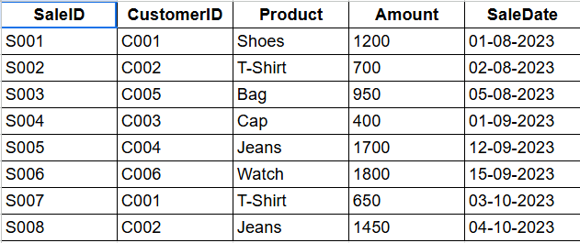
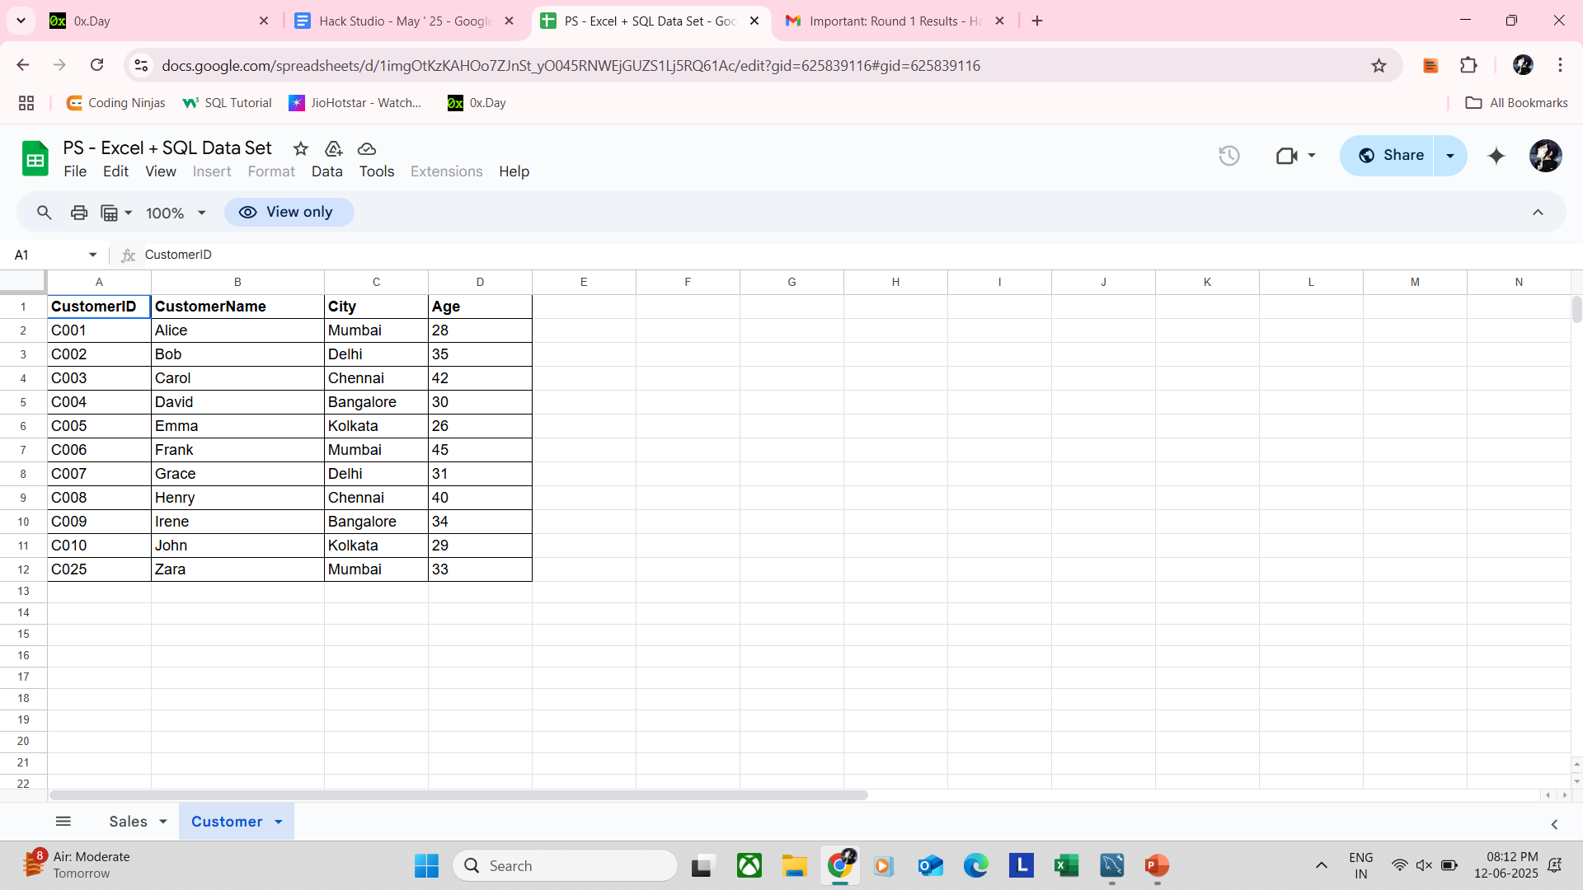
DATA SET
Table Name: sales
Table Name: customer

Slide 2
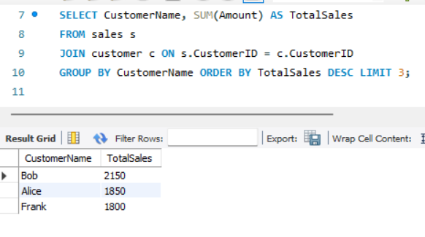
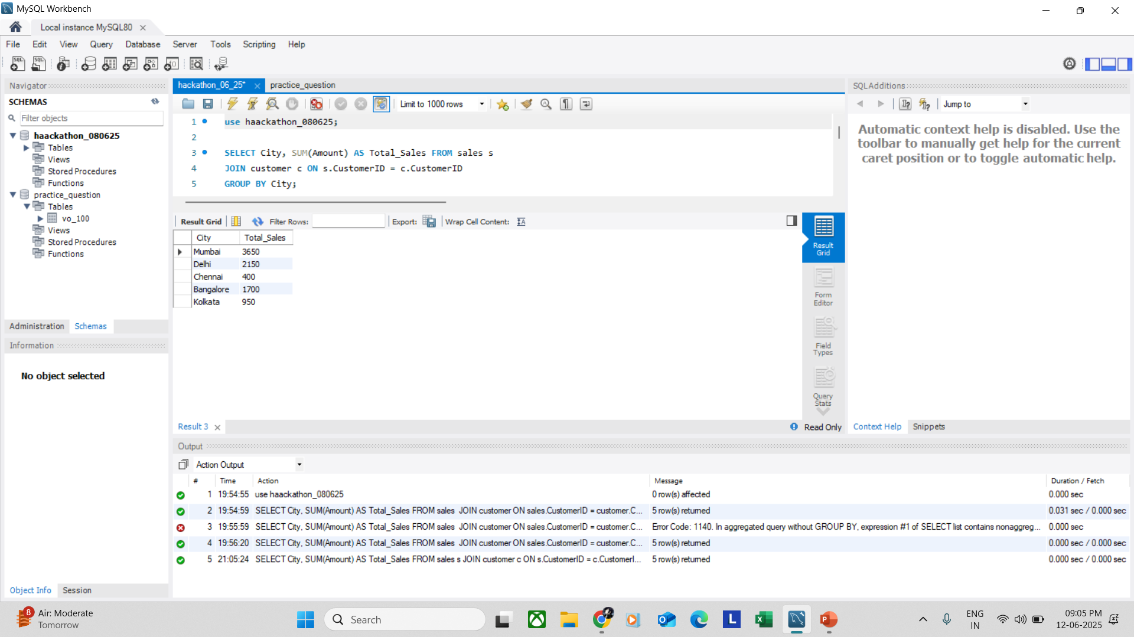
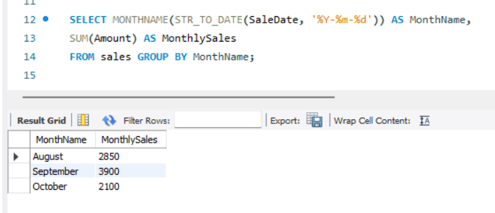
SQL TASK
2. Find the top 3 customers by total sales amount.
1. Write a query to find total sales per city.
3. Display monthly sales (sum of Amount grouped by month).

Slide 3
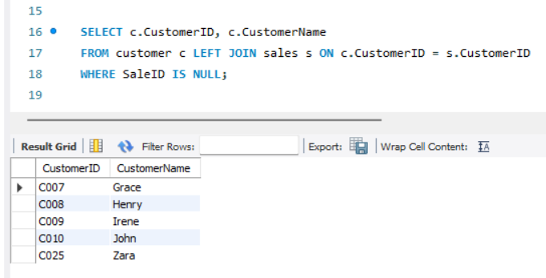
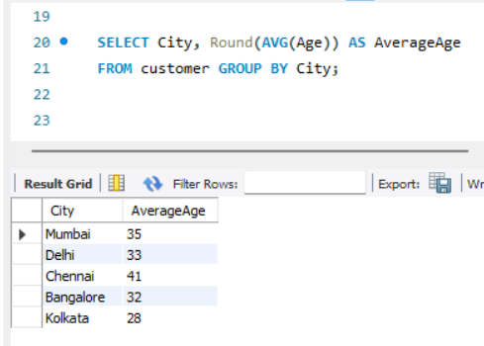
SQL TASK
4. Write a query to find customers who haven’t made any purchase.
5. Find the average age of customers per city.

Slide 4
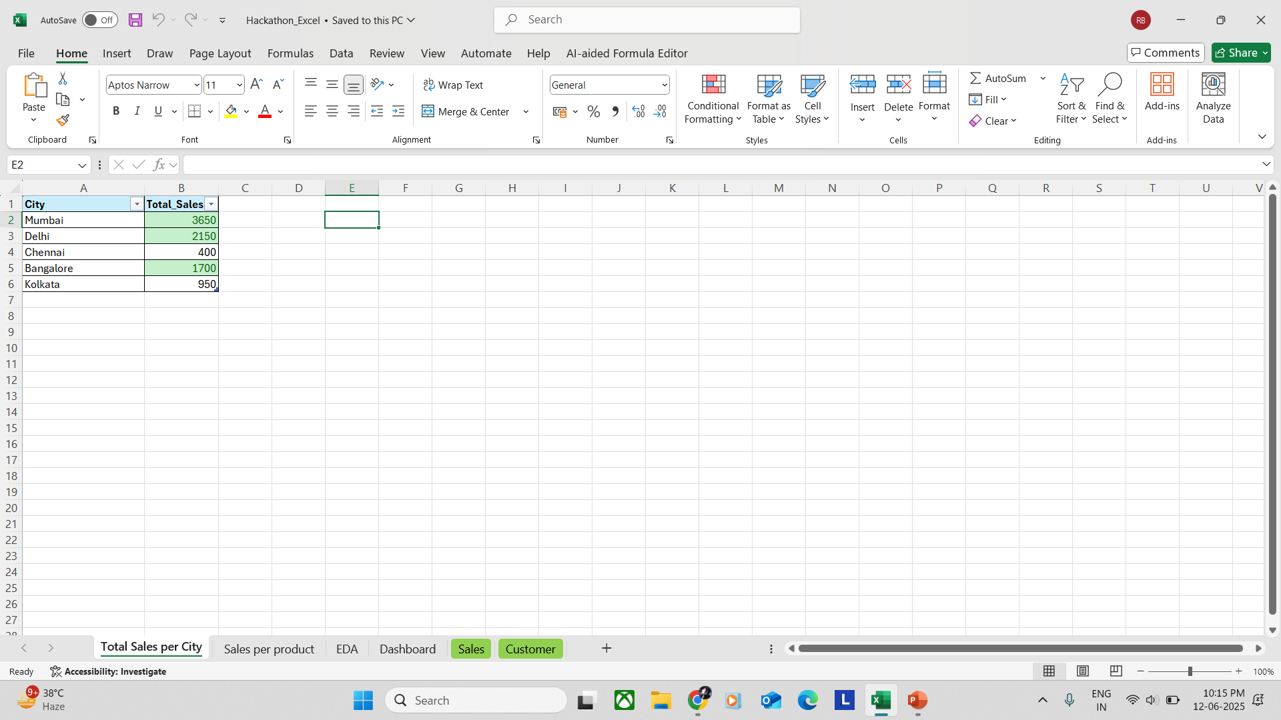
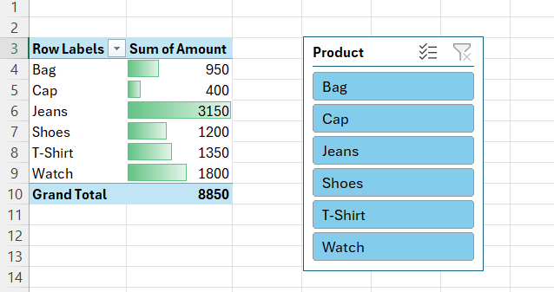
EXCEL TASK
Import SQL query results into Excel (Result of 1st SQL Question).
3. Use conditional formatting to highlight top 3 performing cities from the 1st question's result set “Total Sales per City”.
2. Create a pivot table to show total sales per product.
Bonus Challenges Add a slicer in Excel to filter the dashboard by City or Product. (Additional to 2nd Excel Question)

Slide 5
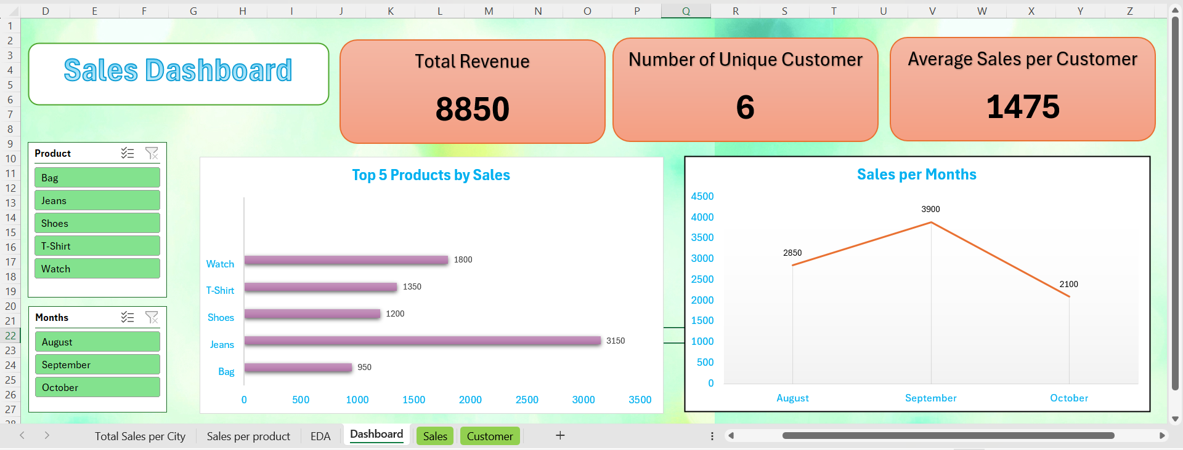
EXCEL TASK
4. Build a dashboard showing:
Total Revenue
Number of Unique Customers
Average Sale per Customer
Monthly Sales (Line Chart)
Visualize the top 5 products in a bar chart.

Slide 6
SUMMARY
Objective: Analyze sales and customer data to identify key trends and actionable insights.
Key Insights
• Top Performing Cities: Mumbai has the highest with 41% of total sales.
• Best-Selling Products: Jeans have highest among all the products, while Cap has least sales.
• Customer Demographics: Majority of purchases come from customers aged 25–35.
• Seasonality or Trends: September month has more sales as compared to other months.
Recommendations
• Focus marketing in high-performing cities like Mumbai and Delhi to maximize revenue growth.
• Consider promotions or utilize discount campaigns for underperforming products.
• Focus marketing efforts among high-value customer demographics.
• Plan inventory based on monthly demand trends.

Slide 7
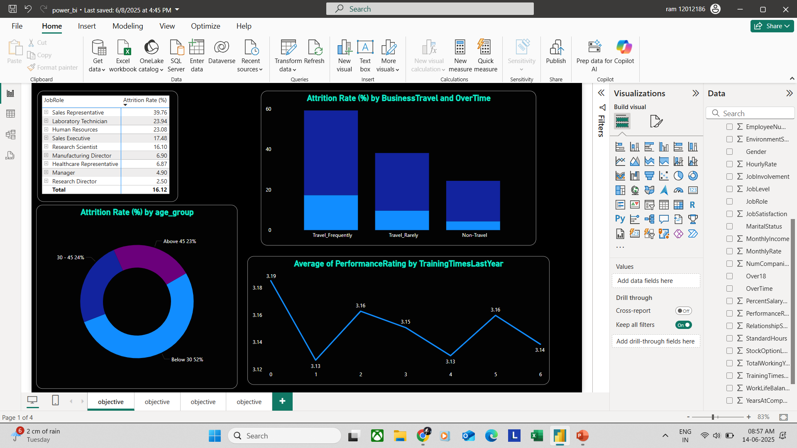
Power BI
Key Insights
Job Role - Sales Representative
Department - Sales
Job Level - 1
Combination of employee show the highest voluntary-attrition rates.
Customer Demographics: Majority of age below 30 has more impact on attrition with 52%
Attrition rates spike among employees who travel frequently and regularly work Overtime.
For similar Job Roles and Job Levels, Monthly Income and Percent Salary Hike doesn't have a specific difference by Gender or Marital Status.

Slide 8
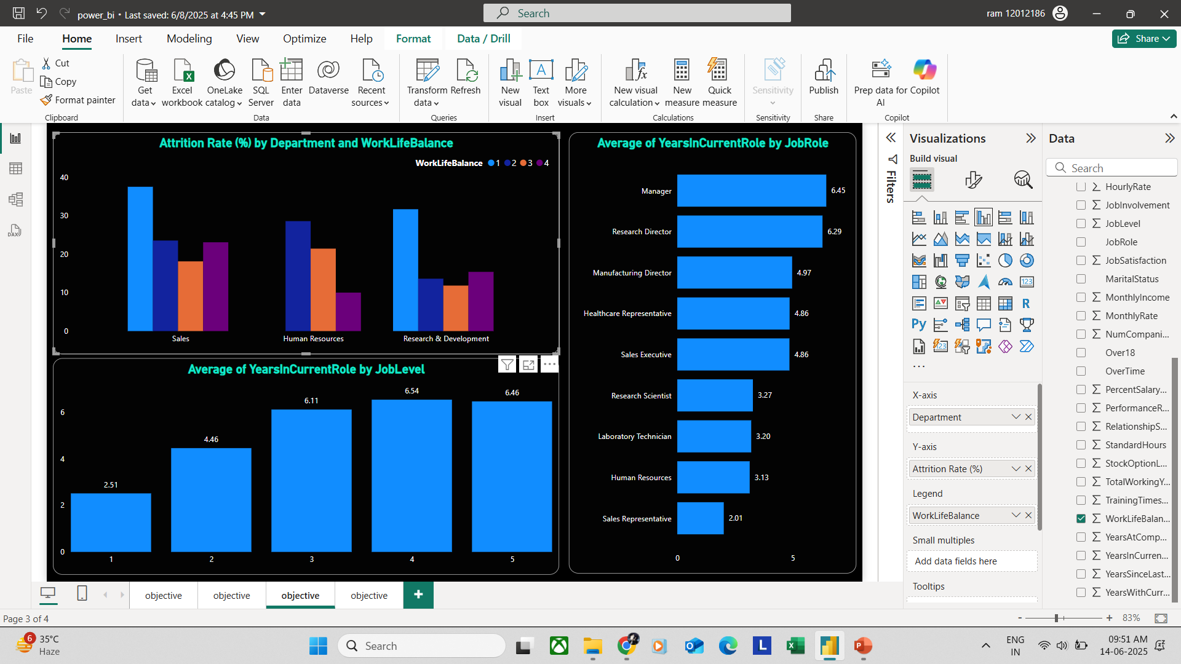
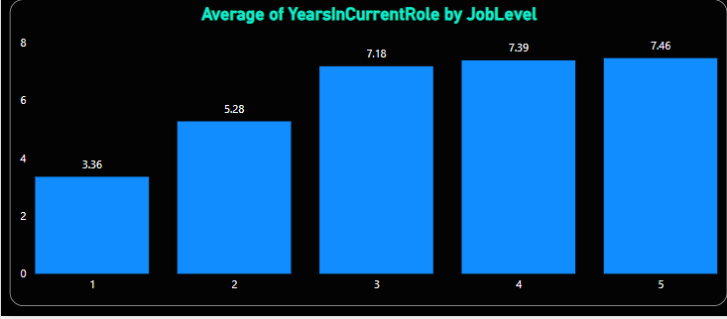
Power BI
Key Insights
Employees with more Total Working Years earn higher Monthly Income
Human Resources, Research & Development departments show balanced outcomes manage to keep both high Work-Life Balance and low attrition simultaneously.
Lower Job Levels (1–2) has faster promotion compared to Job Levels 4–5.

Slide 9
Power BI
Recommendations
Support New Employees in Sales : Sales Executives at level 1 leave the most.
Give them better training and growth paths.
Reduce Overtime & Travel Stress: Offer flexible work hours and travel breaks.
Younger employees leave more (Below 30): Offer growth, learning, facilities, etc.
Fix Work-Life Balance Issues: Promote balance through flexible work policies.
Low balance = more Overtime = more quitting.
HR & R&D Teams: These teams keep both balance and low attrition. Copy their good management and implement the same to other teams.
Link Engagement to Performance: Track and reward engagement,
Those who feel involved and have good relationships perform better.

Slide 10
THANK YOU

